Slide 1
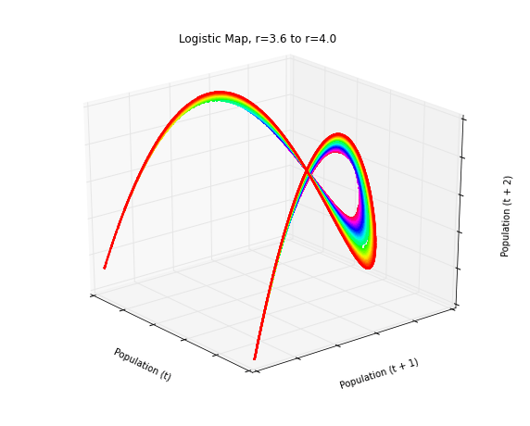
Matplotlib Tutorial : Python Plotting
N. VARUN ARAVINTH SOFTWARE DEVELOPER - IBM

Slide 2
http://matplotlib.sourceforge.net/
A python 2D plotting library
Publication quality figures in several hardcopy formats and interactive environments across platforms
Can be used in
Python scripts,
the Python and IPython shell (a la matlab or mathematica),
web application servers, and
6 GUI toolkits
Toolkits (4)
http://matplotlib.sourceforge.net/users/toolkits.html
E.g., Basemap plots data on map projections (with continental and political boundaries)

Slide 3
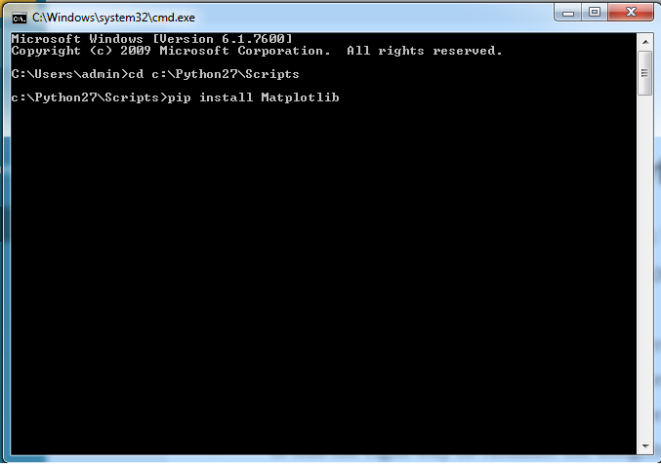
Installation
In the Matplotlib homepage, click on the download link
In the download page, click
matplotlib-1.3.0.win32-py2.7.exe
Download and install
Under C:\Python26\Lib\site-packages, 2 new folders
matplotlib
mpl_toolkits

Slide 4
To test, in the Python command line,
type the 1st example (3 lines plotting a straight line) in the Tutorial (see below)
plot() creates an object and outputs info on it
Not an error report
show() displays a figure
Close it to return from the command

Slide 5
matplotlib.pyplot vs. pylab
Package matplotlib.pyplot provides a MATLAB-like plotting framework
Package pylab combines pyplot with NumPy into a single namespace
Convenient for interactive work
For programming, it’s recommended that the namespaces be kept separate
See such things as
import pylab
Or
import matplotlib.pyplot as plt
The standard alias
import numpy as np
The standard alias

Slide 6
Also
from pylab import *
Or
from matplotlib.pyplot import *
from numpy import *
We’ll use
from pylab import *
Some examples don’t show this—just assume it

Slide 7
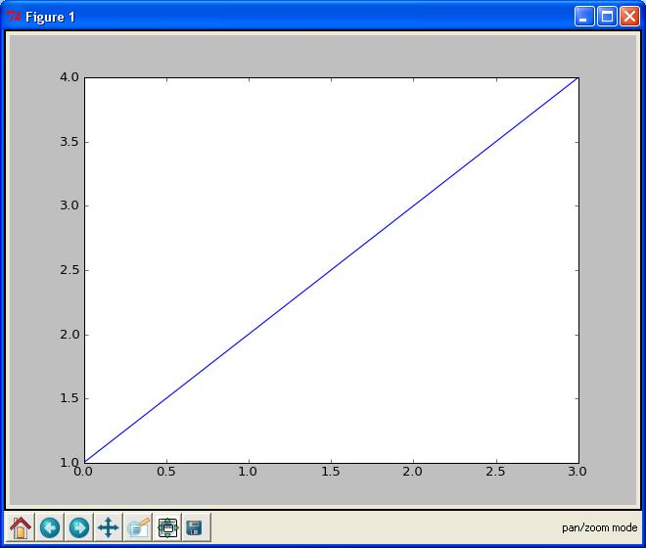
Batch and Interactive Use
In a script,
import the names in the pylab namespace
then list the commands
Example: file E:\SomeFolder\mpl1.py
from pylab import *
plot([1,2,3,4])
show()
Executing
E:\SomeFolder>mpl1.py
produces the figure shown
The command line hangs until the figure is dismissed (click ‘X’ in the upper right)

Slide 8
plot()
Given a single list or array, plot() assumes it’s a vector of y-values
Automatically generates an x vector of the same length with consecutive integers beginning with 0
Here [0,1,2,3]
To override default behavior, supply the x data: plot(x,y )
where x and y have equal lengths
show()
Should be called at most once per script
Last line of the script
Then the GUI takes control, rendering the figure

Slide 9
In place of show(), can save the figure to with, say,
savefig('fig1.png')
Saved in the same folder as the script
Override this with a full pathname as argument—e.g.,
savefig('E:\\SomeOtherFolder\\fig1.png')
Supported formats: emf, eps, pdf, png, ps, raw, rgba, svg, svgz
If no extension specified, defaults to .png

Slide 10
Matplotlib from the Shell
Using matplotlib in the shell, we see the objects produced
>>> from pylab import *
>>> plot([1,2,3,4])
[<matplotlib.lines.Line2D object at 0x01A3EF30>]
>>> show()
Hangs until the figure is dismissed or close() issued
show() clears the figure: issuing it again has no result
If you construct another figure, show() displays it without hanging

Slide 11
draw()
Clear the current figure and initialize a blank figure without hanging or displaying anything
Results of subsequent commands added to the figure
>>> draw()
>>> plot([1,2,3])
[<matplotlib.lines.Line2D object at 0x01C4B6B0>]
>>> plot([1,2,3],[0,1,2])
[<matplotlib.lines.Line2D object at 0x01D28330>]
Shows 2 lines on the figure after show() is invoked
Use close() to dismiss the figure and clear it
clf() clears the figure (also deletes the white background) without dismissing it
Figures saved using savefig() in the shell by default are saved in
C:\Python27
Override this by giving a full pathname

Slide 12
Interactive Mode
In interactive mode, objects are displayed as soon as they’re created
Use ion() to turn on interactive mode, ioff() to turn it off
Example
Import the pylab namespace, turn on interactive mode and plot a line
>>> from pylab import *
>>> ion()
>>> plot([1,2,3,4])
[<matplotlib.lines.Line2D object at 0x02694A10>]
A figure appears with this line on it
The command line doesn’t hang
Plot another line
>>> plot([4,3,2,1])
[<matplotlib.lines.Line2D object at 0x00D68C30>]
This line is shown on the figure as soon as the command is issued

Slide 13
Turn off interactive mode and plot another line
>>> ioff()
>>> plot([3,2.5,2,1.5])
[<matplotlib.lines.Line2D object at 0x00D09090>]
The figure remains unchanged—no new line
Update the figure
>>> show()
The figure now has all 3 lines
The command line is hung until the figure is dismissed

Slide 14
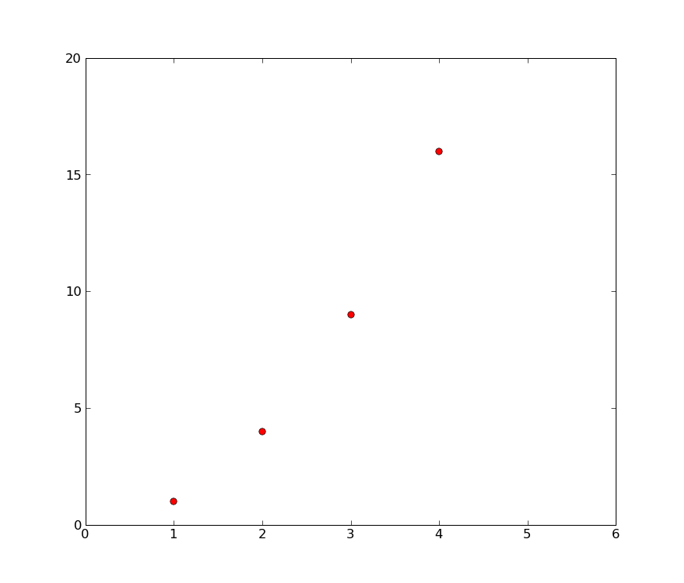
The axis() command takes a list
[xmin, xmax, ymin, ymax]
and specifies the view port of the axes
Example
In [1]: plot([1,2,3,4], [1,4,9,16], 'ro')
Out[1]: [<matplotlib.lines.Line2D object at 0x034579D0>]
In [2]: axis([0, 6, 0, 20])
Out[2]: [0, 6, 0, 20]

Slide 15
More Curve Plotting
plot() has a format string argument specifying the color and line type
Goes after the y argument (whether or not there’s an x argument)
Can specify one or the other or concatenate a color string with a line style string in either order
Default format string is 'b-' ( solid blue line)
Some color abbreviations
b (blue), g (green), r (red), k (black), c (cyan)
Can specify colors in many other ways (e.g., RGB triples)
Some line styles that fill in the line between the specified points
- (solid line), -- (dashed line), -. (dash-dot line), : (dotted line)
Some line styles that don’t fill in the line between the specified point
o (circles), + (plus symbols), x (crosses), D (diamond symbols)
For a complete list of line styles and format strings,
http://matplotlib.sourceforge.net/api/pyplot_api.html#module-matplotlib.pyplot
Look under matplotlib.pyplot.plot()

Slide 16
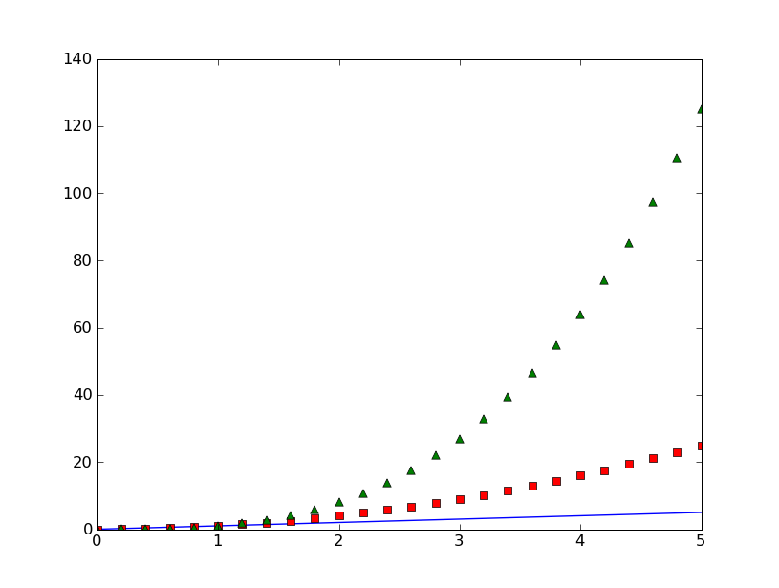
In [1]: t = arange(0.0, 5.2, 0.2)
In [2]: plot(t, t, t, t**2, 'rs', t, t**3, 'g^')
Out[2]:
[<matplotlib.lines.Line2D object at 0x02A6D410>,
<matplotlib.lines.Line2D object at 0x02A6D650>,
<matplotlib.lines.Line2D object at 0x02A6D8D0>]

Slide 17
Lines you encounter are instances of the Line2D class
Instances have the following properties
Property | Values
alpha | The alpha transparency on 0-1 scale
antialiased | True | False - use antialised rendering
color | a matplotlib color arg
label | a string optionally used for legend
linestyle | One of -- : -. -
linewidth | a float, the line width in points
marker | One of + , o . s v x > < ^
markeredgewidth | The line width around the marker symbol
markeredgecolor | The edge color if a marker is used
markerfacecolor | The face color if a marker is used
markersize | The size of the marker in points
alpha = 0.0 is complete transparency, alpha = 1.0 is complete opacity

Slide 18
One of 3 ways to set line properties: Use keyword line properties as keyword arguments—e.g.,
plot(x, y, linewidth=2.0)
Another way: Use the setter methods of the Line2D instance
For every property prop, there’s a set_prop() method that takes an update value for that property
To use this, note that plot() returns a list of lines
The following has 1 line with tuple unpacking
line, = plot(x, y, 'o')
line.set_antialiased(False)

Slide 19
Text
The text commands are self-explanatory
xlabel()
ylabel()
title()
text()
In simple cases, all but text() take just a string argument
text() needs at least 3 arguments:
x and y coordinates (as per the axes) and a string
All take optional keyword arguments or dictionaries to specify the font properties
They return instances of class Text

Slide 20
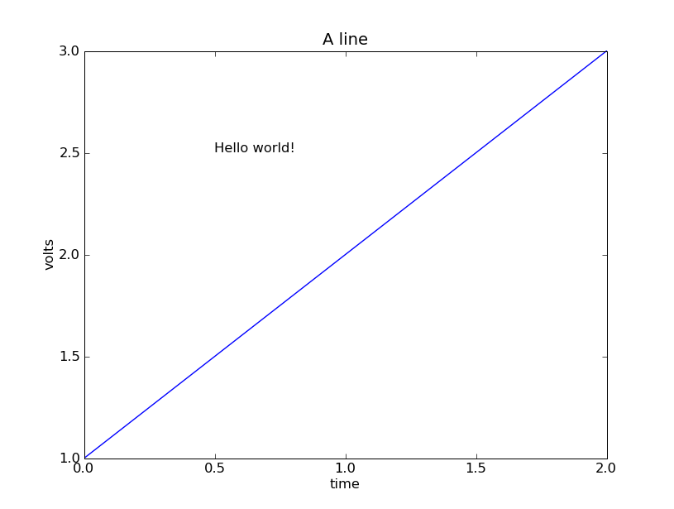
plot([1,2,3])
xlabel('time')
ylabel('volts')
title('A line')
text(0.5, 2.5, 'Hello world!')

Slide 21
The following font properties of Text instances can be set
Property | Values
alpha | The alpha transparency on 0-1 scale
color | a matplotlib color argument
fontangle | italic | normal | oblique
fontname | Sans | Helvetica | Courier | Times | Others
fontsize | a scalar, eg, 10
fontweight | normal | bold | light 4
horizontalalignment | left | center | right
rotation | horizontal | vertical
verticalalignment | bottom | center | top

Slide 22
Three ways to specify font properties: using
setp
object oriented methods (We skip this)
font dictionaries
Use setp to set any property
t = xlabel('time')
setp(t, color='r', fontweight='bold')
Also works with a list of text instances—e.g.,
labels = getp(gca(), 'xticklabels')
setp(labels, color='r', fontweight='bold')

Slide 23
All text commands take an optional dictionary argument and keyword arguments to control font properties
E.g., to set a default font theme and override individual properties for given text commands
font = {'fontname' : 'Courier',
'color' : 'r',
'fontweight' : 'bold',
'fontsize' : 11}
plot([1,2,3])
title('A title', font, fontsize=12)
text(0.5, 2.5, 'a line', font, color='k')
xlabel('time (s)', font)
ylabel('voltage (mV)', font)

Slide 24
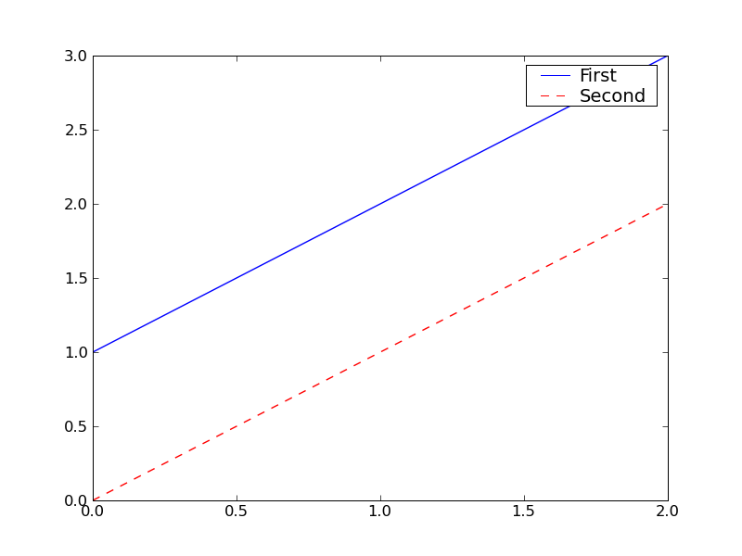
Legends
A legend is a box (by default in upper right) associating labels with lines (displayed as per their formats)
legend(lines, labels)
where lines is a tuple of lines, labels a tuple of corresponding strings
from pylab import *
lines = plot([1,2,3],'b-',[0,1,2],'r--')
legend(lines, ('First','Second'))
savefig('legend')

Slide 25
If there’s only 1 line, be sure to include the commas in the tuples
lengend((line1,), ('Profit',))
Use keyword argument loc to override the default location
Use predefined strings or integer codes
‘upper right’ 1
‘upper left’ 2
‘lower left’ 3
‘lower right’ 4
‘right’ 5
‘center left’ 6
‘center right’ 7
‘lower center’ 8
‘upper center’ 9
‘center’ 10
E.g.,
legend((line,), ('Profit',) , loc=2)

Slide 26
Bar Charts
Function bar() creates a bar chart
Most of the arguments may be either scalars or sequences
Say in […] what they normally are
Required arguments
left x coordinates of the left sides of the bars [sequence]
height height of the bars [sequence]

Slide 27
Some optional keyword arguments
orientation orientation of the bars (‘vertical’ | ‘horizontal’)
width width of the bars [scalar]
color color of the bars [scalar]
xerr if not None,
generates error ticks on top the bars [sequence]
yerr if not None,
generates errorbars on top the bars [sequence]
ecolor color of any errorbar [scalar]
capsize length (in points) of errorbar caps (default 2) [scalar]
log False (default) leaves the orientation axis as is,
True sets it to log scale

Slide 28
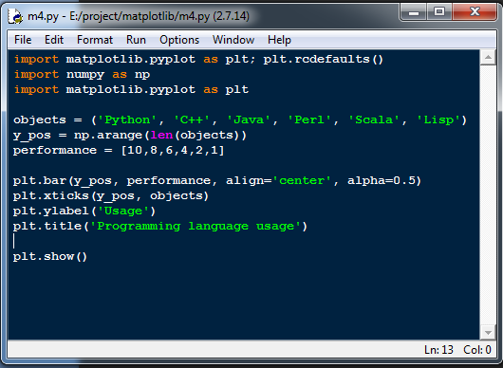
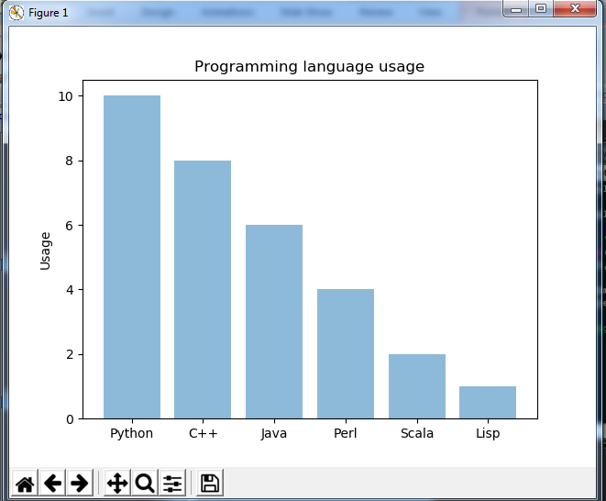

Slide 29
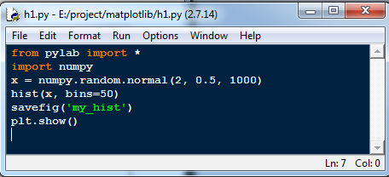
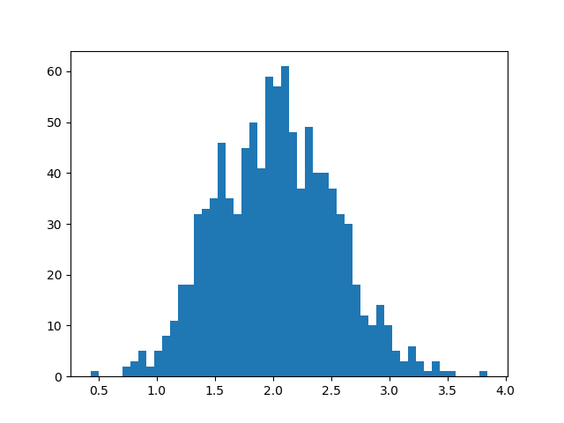
Histograms

Slide 30
Keyword Arguments
s
If an integer, size of marks in points² , i.e., area occupied (default 20)
If an array of length N, gives the sizes of the corresponding elements of x, y
marker
Symbol marking the points (default = ‘o’)
Same options as for lines that don’t connect the dots
And a few more
c
A single color or a length-N sequence of colors

Slide 31
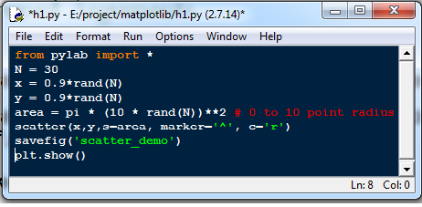
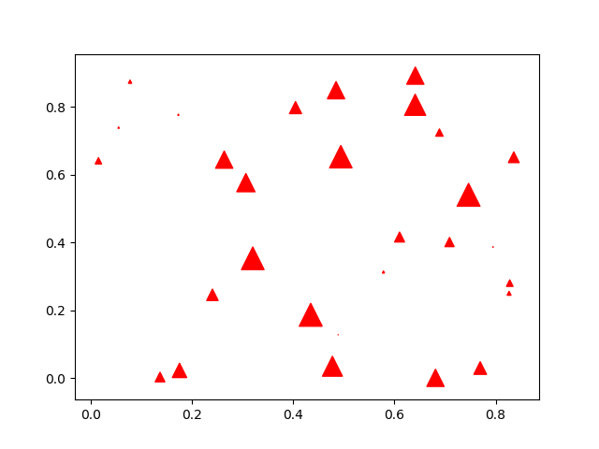

Slide 32
Odds and Ends Horizontal and Vertical Lines
hlines(y, xmin, xmax )
Draw horizontal lines at heights given by the numbers in array y
If xmin and xmax are arrays of same length as y, they give the left and right endpoints of the corresponding lines, resp.
If either is a scalar, all lines have the same endpoint, specified by it
Some keyword arguments
linewidth (or lw): line width in points
color: default ‘k’
vlines(x, ymin, ymax ) is similar but for vertical lines

Slide 33
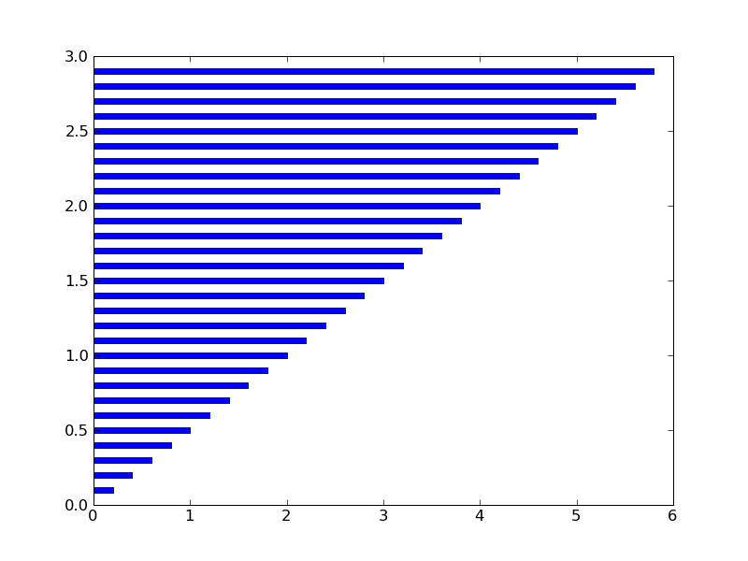
from pylab import *
y = arange(0,3,0.1)
x = 2*y
hlines(y, 0, x, color='b', lw=4)
savefig('hlines')

Slide 34
Axis Lines
axhline() draws a line on the x axis spanning the horizontal extent of the axes
axhline(y ) draws such a line parallel to the x axis at height y
Some keyword arguments
color: default ‘b’
label
linewidth in points
axvline() is similar but w.r.t. the y axis

Slide 35
Grid Lines
grid(True) produces grid lines at the tick coordinates
grid(None) suppresses the grid
grid() toggles the presence of the grid
Some keyword arguments
color: default ‘k’
linestyle: default ‘:’
linewidth
Some Axes instance methods
get_xgridlines()
get_ygridlines()
Example:
setp(gca().get_xgridlines(), color='r')

Slide 36
Resizing the Figure
Often should make the figure wider or higher so objects aren’t cramped
Use Figure instance methods get_size_inches() and set_size_inches()
To get an array of the 2 dimensions in inches (width then height):
fig = gcf()
dsize = fig.get_size_inches()
E.g., to double the width
fig.set_size_inches( 2 * dsize[0], dsize[1] )
See the example in the SciPy Cookbook
http://www.scipy.org/Cookbook/Matplotlib/AdjustingImageSize

Slide 37
Multiple Subplots
Functions axes() and subplot() both used to create axes
subplot() used more often
subplot(numRows, numCols, plotNum)
Creates axes in a regular grid of axes numRows by numCols
plotNum becomes the current subplot
Subplots numbered top-down, left-to-right
1 is the 1st number
Commas can be omitted if all numbers are single digit
Subsequent subplot() calls must be consistent on the numbers or rows and columns

Slide 38
subplot() returns a Subplot instance
Subplot is derived from Axes
Can call subplot() and axes() in a subplot
E.g., have multiple axes in 1 subplot
See the Tutorial for subplots sharing axis tick labels

Slide 39
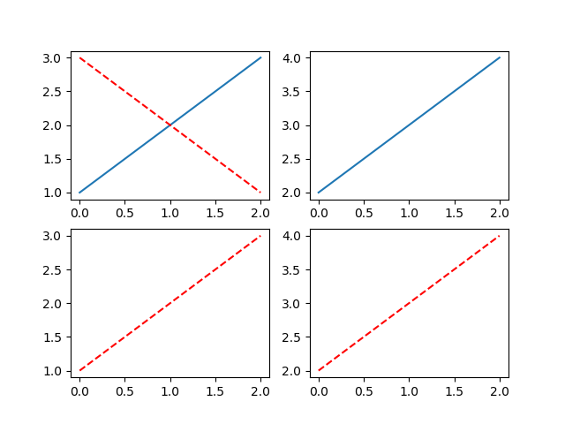
from pylab import *
subplot(221)
plot([1,2,3])
subplot(222)
plot([2,3,4])
subplot(223)
plot([1,2,3], 'r--')
subplot(224)
plot([2,3,4], 'r--')
subplot(221)
plot([3,2,1], 'r--')
savefig('subplot')

Slide 40
3D Matplotlib: mplot3d
See http://matplotlib.org/mpl_toolkits/mplot3d/tutorial.html
An Axes3D object is created like any other axes, but using the projection='3d' keyword
Create a new matplotlib.figure.Figure and add to it a new axes of type Axes3D
import matplotlib.pyplot as plt
from mpl_toolkits.mplot3d import Axes3D
fig = plt.figure()
ax = fig.add_subplot(111, projection='3d')

Slide 41
Example: Line Plots
Axes3D.plot(xs, ys, *args, **kwargs)
Plot 2D or 3D data
xs, ys are the arrays of x, y coordinates of vertices
zs is the z value(s), either 1 for all points or (as array) 1 for each point
zdir gives which direction to use as z (‘x’, ‘y’ or ‘z’) when plotting a 2D set
Other arguments are passed on to plot()

Slide 42
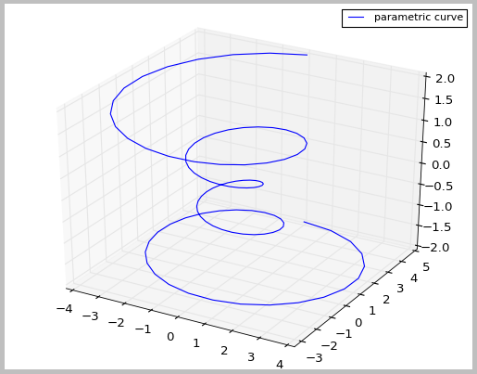
Example
import matplotlib as mpl
from mpl_toolkits.mplot3d import Axes3D
import numpy as np
import matplotlib.pyplot as plt
mpl.rcParams['legend.fontsize'] = 10
fig = plt.figure()
ax = fig.gca(projection='3d')
theta = np.linspace(-4 * np.pi, 4 * np.pi, 100)
z = np.linspace(-2, 2, 100)
r = z**2 + 1
x = r * np.sin(theta)
y = r * np.cos(theta)
ax.plot(x, y, z, \
label='parametric curve')
ax.legend()
plt.show()

Slide 43
Animation
To take an animated plot and turn it into a movie,
save a series of image files (e.g., PNG) and
use an external tool to convert them to a movie
Can use mencoder, part of the mplayer suite
See http://www.mplayerhq.hu/design7/news.html
Can download binaries for Windows
Or use ImageMagick’s convert (“the Swiss army knife of image tools”)
See http://www.imagemagick.org/script/convert.php

Slide 44
Matplotlib Animation
Matplotlib Animation Tutorial
http://jakevdp.github.com/blog/2012/08/18/matplotlib-animation-tutorial/
Matplotlib animation documentation
http://matplotlib.org/api/animation_api.html
Matplotlib animation examples
http://matplotlib.org/examples/animation/
Official and good, but documentation limited to meager program comments
The tutorial (above) goes through several of these
Alias http://matplotlib.sourceforge.net/examples/animation/index.html
This replaces the Cookbook examples
http://www.scipy.org/Cookbook/Matplotlib/Animations

Slide 45
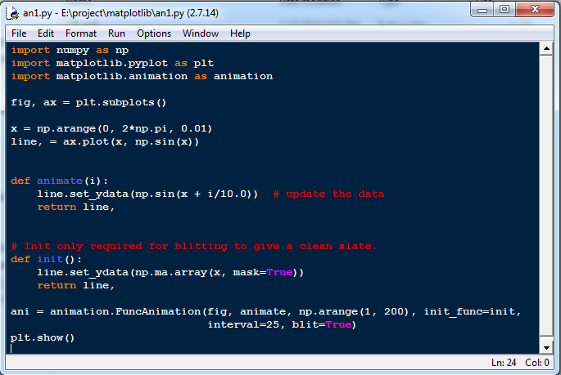
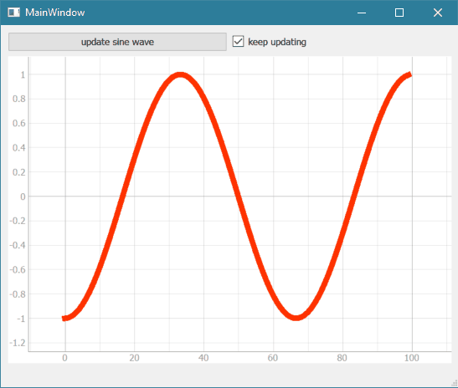

Slide 46
THANK YOU
WELCOME

